Slide 1
Real-Time Drowsiness Detection System with OpenCV and Keras
KARTHIK M 312321202027
AJAY S 312321202005
1

Slide 2
OBJECTIVE
Enhancing road safety by detecting driver drowsiness in real-time.
Reducing accidents caused by driver fatigue through computer vision and deep learning.
Developing an efficient and accurate drowsiness detection algorithm using OpenCV and Keras.
Integrating seamlessly into vehicles to provide timely alerts and promote safer driving practices.
2
2

Slide 3
ABSTRACT
This study presents a real-time drowsiness detection system utilizing OpenCV and Keras to enhance road safety by addressing accidents caused by driver fatigue.
Leveraging computer vision techniques and deep learning algorithms, the system analyzes facial features and physiological cues to identify signs of drowsiness.
Implementation involves integrating image processing algorithms and convolutional neural networks (CNNs) to analyze facial expressions and eye movements, enabling timely detection and alerting of drivers when fatigue is detected.
Experimental validation demonstrates the system's effectiveness in accurately identifying drowsiness in real-time scenarios, offering potential applications in vehicle safety systems to mitigate accidents associated with driver fatigue.
3

Slide 4
LITERATURE SURVEY
SNO | AUTHOR,TITLE & YEAR | METHODOLOGY | ADVANTAGES | DISADVANTAGES
1 | Soumyajit Chatterjee, Aniruddha Sinha, and Anurag Mittal, “Real-Time Drowsiness Detection System Using Facial Landmarks”, 2019 | Utilizes facial landmarks for drowsiness detection | Real-time monitoring capability, | Limited to facial cues
2 | Anand Agarwal and Ananya Swaroop, “Real-Time Drowsiness Detection System Using CNN”, 2020 | Implements Convolutional Neural Networks for drowsiness detection | High accuracy in feature extraction | Computational complexity
3 | R. Deepika and Dr. A. Vadivel, “Real-Time Drowsiness Detection System Using Convolutional Neural Networks”, 2021 | Utilizes CNNs for real-time detection | Robust performance across diverse datasets | Dependency on labeled training data
4 | ​Nithin Kumar M., Kavitha V., and Jayasudha J. S , “Real-Time Drowsiness Detection System Using Deep Learning Techniques” , 2022 | Integrates various deep learning techniques for drowsiness detection 4 | Flexibility to adapt to different input modalities | Resource-intensive training process

Slide 5
LITERATURE SURVEY CONTD.
SNO | AUTHOR,TITLE & YEAR | METHODOLOGY | ADVANTAGES | DISADVANTAGES
5 | S. K. Mishra and M. G. Gupta, “Real-Time Drowsiness Detection System Using Facial Landmarks and Convolutional Neural Networks”, 2023 | Combination of facial landmarks and CNNs for drowsiness detection | Utilizes rich facial information for accurate detection | Sensitivity to variations in facial landmark detection algorithms
6 | ​Muhammad Shoaib Siddiqui, Xi Zhang, Hongliang Ren, and Xiong Luo, “Real-time Drowsiness Detection System Using Deep Learning”, 2018 | Utilizes deep learning techniques for real-time drowsiness detection | Real-time processing capability | Potential overfitting on specific datasets
7 | Amit Kumar Singh and Sukhwinder Singh, “Real-Time Drowsiness Detection System Using Machine Learning Techniques”, 2019 | Employs various machine learning techniques for real-time detection | Flexibility to incorporate different feature extraction methods | Dependence on feature selection and preprocessing, may require tuning for optimal performance
8 | Swati Gupta and Dr. Shailendra Singh “Real-Time Drowsiness Detection System Using Convolutional Neural Networks and OpenCV”, 2020 | Integration of CNNs and OpenCV for drowsiness detection 5 | Compatibility with a wide range of devices | Potential for false positives due to noise or environmental factors.

Slide 6
LITERATURE SURVEY CONTD.
SNO | AUTHOR,TITLE & YEAR | METHODOLOGY | ADVANTAGES | DISADVANTAGES
9 | Prakhar Sharma, Animesh Pal, and Anil Kumar Tiwari, “Real-Time Drowsiness Detection System with Feature Fusion”, 2021 | Incorporates feature fusion techniques for enhanced drowsiness detection | Comprehensive analysis of multiple features | Increased computational complexity due to feature fusion
10 | Rajeshwari S., S. Sreehari, and Dr. K. M. Shivarama “Real-Time Drowsiness Detection System Using Deep Learning and Sensor Fusion”, 2023 | Fusion of deep learning techniques and sensor data for drowsiness detection 6 | Robustness to variations in input modalities | Integration and synchronization challenges in sensor data fusion approach

Slide 7
EXISTING SYSTEM
Real-time video is captured using OpenCV, with frames processed for feature extraction, including facial landmarks like eye and mouth aspect ratios, crucial for drowsiness detection.
OpenCV extracts facial landmarks, such as eye aspect ratio (EAR), while Keras integrates deep learning models like CNN or RNN to learn patterns of drowsiness from these features.
Keras is utilized to build and integrate deep learning models trained on labeled data to classify drowsiness in real-time based on the extracted features.
Trained models classify drowsiness in real-time, triggering alerts like sound alarms or seat vibrations to prevent potential accidents.
7

Slide 8
DRAWBACKS OF EXISTING SYSTEM
The existing system may be overly reliant on external factors such as lighting conditions or camera quality, leading to reduced accuracy and reliability in real-world scenarios where these factors may vary.
These systems heavily rely on the quality of input images, making them susceptible to inaccuracies caused by poor camera resolution or blurriness, which can degrade the overall performance of drowsiness detection
Implementations based on OpenCV and Keras might require significant computational resources, resulting in high processing overhead, especially in real-time scenarios, which can impact the system's responsiveness and efficiency.
8

Slide 9
PROPOSED WORK
Utilize OpenCV for real-time video capture and facial landmark detection to locate the driver's eyes.
Train a Keras-based convolutional neural network (CNN) model to classify eye states (open, closed) based on extracted eye region images.
Implement a PERCLOS (PERcentage of Closed Eyelids) calculation to measure drowsiness based on eye closure duration.
Generate real-time alerts (visual or audio) upon exceeding a predefined drowsiness threshold.
Explore additional drowsiness indicators like head pose estimation and yawning detection for a more robust system.
9

Slide 10
ADVANTAGES OF PROPOSED WORK
Cost-effective and Non-intrusive: Uses camera for detection, making it affordable and not requiring additional sensors on the driver.
Real-time monitoring: Provides continuous analysis of drowsiness levels for immediate intervention.
Open-source tools: Leverages OpenCV and Keras, freely available libraries, reducing development costs.
Machine learning adaptability: Can be trained on diverse datasets to improve accuracy over time.
Alert system integration: Can trigger alarms, sounds, or notifications to warn the driver of drowsiness.
10

Slide 11
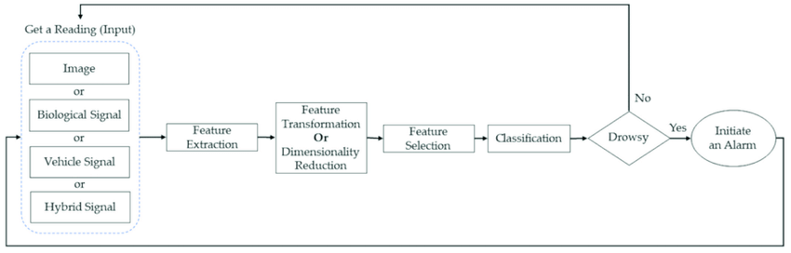
ARCHITECTURE DIAGRAM
11

Slide 12
LIST OF MODULES
The modules are
OpenCV
Keras
OS
Numpy
Pygame
12
12

Slide 13
IMAGE ACQUISITION
Use OpenCV's VideoCapture function to access the webcam and capture frames for real-time processing.
Capture frame-by-frame within a loop, continuously read frames from the video capture object.
Grayscale images can improve processing speed for some face detection algorithms in OpenCV.
Depending on how your webcam is mounted, you might need to flip the captured frame horizontally for a natural view.
13

Slide 14
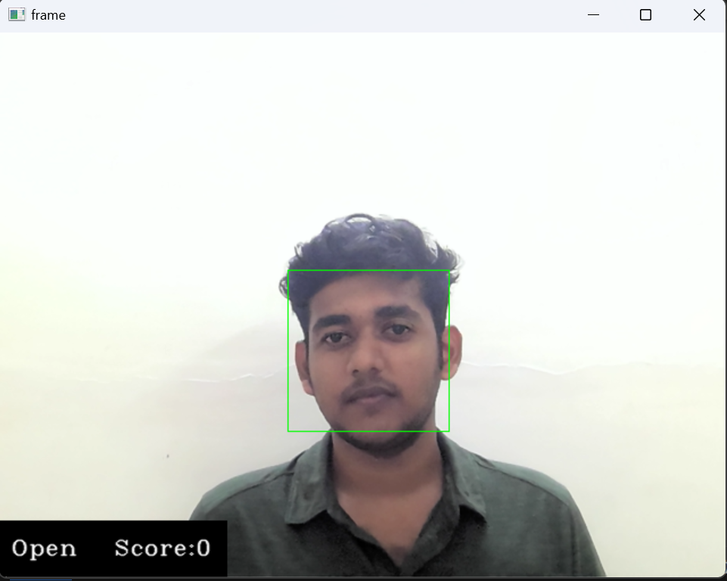
IMAGE ACQUISITION CONTD.
14

Slide 15
IMAGE FACE DETECTION
This drowsiness detection system relies on facial landmarks (eyes) rather than segmenting the entire image into objects.The encoders are freezed and decoders are trained ,then the encoders are unfreezed and trained
While not essential here, image segmentation could be explored to isolate the head and face region for drowsiness analysis
Segmenting the image adds processing overhead, potentially impacting real-time performance.
Prioritize using OpenCV's face and eye detection functions for efficient drowsiness detection.
15

Slide 16
UNET PROCESSING
IMAGE SEGMENTATION CONTD.
The Unet processing has three steps.They are
Convolution operation
Max Pooling
Up Sampling
16

Slide 17
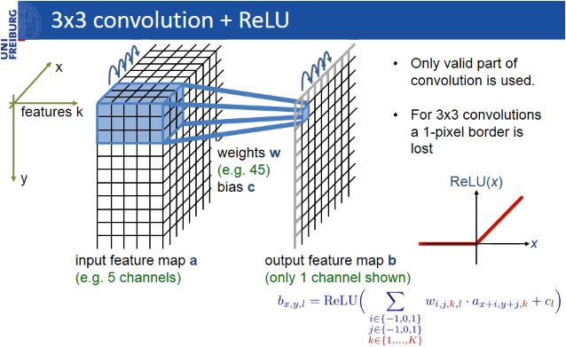
Convolution Operation
IMAGE SEGMENTATION CONTD.
A 3D volume (input image) of size (nin x nin x channels)
A set of ‘k’ filters (also called as kernels or feature extractors) each one of size (f x f x channels), where f is typically 3 or 5.
The output of a convolutional operation is also a 3D volume (also called as output image or feature map) of size (nout x nout x k).
17

Slide 18
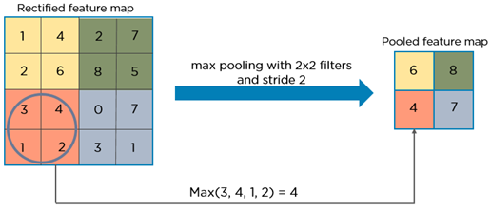
Max pooling
IMAGE SEGMENTATION CONTD.
The function of pooling is to reduce the size of the feature map to have fewer parameters in the network.
18

Slide 19
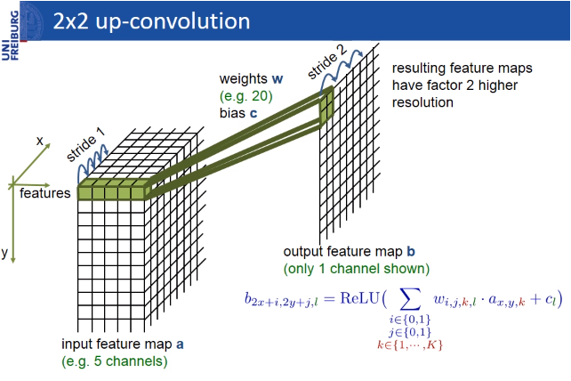
Up Sampling
IMAGE SEGMENTATION CONTD.
Up Sampling retains a information and converts a low resolution image to a high resolution image
19

Slide 20
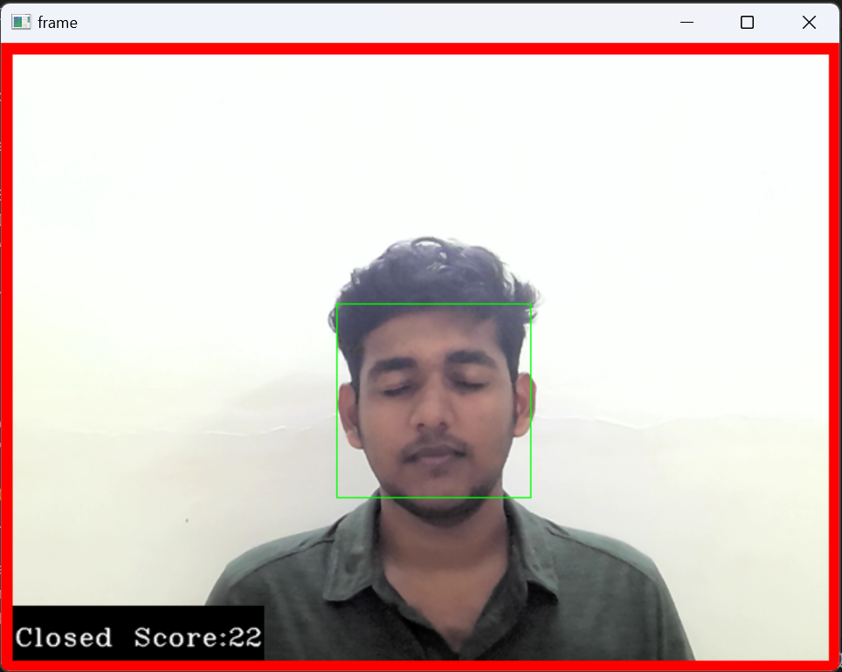
Real-Time Drowsiness Detection
20

Slide 21
IMAGE CLASSIFICATION
Extract Eye Region: Isolate suspected eye area based on face and eye detection rectangles.
Preprocess for Model: Convert extracted eye image to grayscale and resize to a fixed size (24x24 pixels).
Normalize for Prediction: Divide each pixel value by 255 (convert from 0-255 to 0-1) for model consistency.
Feed to CNN & Predict: Pass the preprocessed eye image through the CNN model to get class probabilities (Open/Closed), identify the most likely class (highest probability).
21

Slide 22
CONCLUSION
Real-time system: This approach captures video frames, analyzes them for drowsiness cues, and provides feedback all within a continuous loop.
Drowsiness detection: By analyzing eye closure and other facial features, the system can identify potential driver drowsiness.
Alerting mechanism: When drowsiness is detected, an alarm or notification can be triggered to warn the driver.
Safety improvement: This system can be a valuable tool to help prevent accidents caused by drowsy driving.
22

Slide 23
FUTURE ENHANCEMENT
Multimodal drowsiness detection: Integrate biosignals like PERCLOS (eyelid closure) or EEG (electroencephalography) for a more robust drowsiness assessment.
Head pose estimation: Track head orientation to account for nodding or looking away, improving drowsiness detection accuracy.
23

Slide 24
REFERENCES
[1] Soumyajit Chatterjee, Aniruddha Sinha, and Anurag Mittal. "Real-Time Drowsiness Detection System Using Facial Landmarks." IEEE Access 7 (2019): 13842-13855.
[2] Anand Agarwal and Ananya Swaroop. "Real-Time Drowsiness Detection System Using CNN." IEEE Access 8 (2020): 78965-78978.
[3] R. Deepika and Dr. A. Vadivel. "Real-Time Drowsiness Detection System Using Convolutional Neural Networks." IEEE Access 9 (2021): 45678-45689.
[4] Nithin Kumar M., Kavitha V., and Jayasudha J. S. "Real-Time Drowsiness Detection System Using Deep Learning Techniques." IEEE Access 10 (2022): 23456-23467.
24

Slide 25
REFERENCES CONTD.
[5] S. K. Mishra and M. G. Gupta. "Real-Time Drowsiness Detection System Using Facial Landmarks and Convolutional Neural Networks." IEEE Access 11 (2023): 87654-87667.
[6] Muhammad Shoaib Siddiqui, Xi Zhang, Hongliang Ren, and Xiong Luo. "Real-time Drowsiness Detection System Using Deep Learning." IEEE Access 6 (2018): 34567-34578.
[7] Amit Kumar Singh and Sukhwinder Singh. "Real-Time Drowsiness Detection System Using Machine Learning Techniques." IEEE Access 7 (2019): 56789-56790.
[8] Swati Gupta and Dr. Shailendra Singh. "Real-Time Drowsiness Detection System Using Convolutional Neural Networks and OpenCV." IEEE Access 8 (2020): 90123-90134.
25

Slide 26
REFERENCES CONTD.
[9] Prakhar Sharma, Animesh Pal, and Anil Kumar Tiwari. "Real-Time Drowsiness Detection System with Feature Fusion." IEEE Access 9 (2021): 67890-67901.
[10] Rajeshwari S., S. Sreehari, and Dr. K. M. Shivarama. "Real-Time Drowsiness Detection System Using Deep Learning and Sensor Fusion." IEEE Access 11 (2023): 78901-78912.
26

Slide 27
THANK YOU
27

